Slide 1
Digital Portfolio
STUDENT NAME: Faran. V
REGISTER NO AND NMID: 20924u09054 &57F1B53BABDB30DA88E4F52F54BA5832
DEPARTMENT: BCA
COLLEGE: COLLEGE/ UNIVERSITY Shanmuga industries arts and science college

Slide 2
PROJECT TITLE
My portfolio

Slide 3


AGENDA
Problem Statement
Project Overview
End Users
Tools and Technologies
Portfolio design and Layout
Features and Functionality
Results and Screenshots
Conclusion
Github Link
3/21/2024 Annual Review

Slide 4

PROBLEM STATEMENT
Many developers and designers struggle to showcase their skills, experience, and projects in an attractive and professional way. Without a personal portfolio website, it becomes harder to highlight abilities to recruiters, clients, or collaborators. The problem is to create a simple, responsive, and visually appealing portfolio that effectively represents an individual’s work and skills.

Slide 5

PROJECT OVERVIEW
This project is a personal portfolio website built using HTML, CSS, and JavaScript. It includes sections like About Me, Projects, and Contact. The goal is to provide an online platform where visitors can learn about the developer, view sample projects, and connect easily. The website is responsive, user-friendly, and designed with modern aesthetics.

Slide 6

WHO ARE THE END USERS?
Recruiters/Employers → To evaluate the developer’s skills and projects. Clients → To view past work and contact for freelance opportunities. Peers/Collaborators → To explore work and connect for potential collaborations. General Visitors → To learn more about the developer’s background and abilities.

Slide 7

TOOLS AND TECHNIQUES
HTML5 → Structure and content of the website. CSS3 → Styling, layout, responsiveness, and design aesthetics. JavaScript (Vanilla JS) → Smooth scrolling, form handling, and interactive features. Placeholder Images → Used for sample projects (can be replaced with real images).

Slide 8
POTFOLIO DESIGN AND LAYOUT
Navbar/Header → Sticky navigation with logo and section links. Hero Section → Full-screen intro with name, role, and call-to-action button. About Section → Brief introduction about the developer. Projects Section → Card-style layout to showcase sample projects with images, titles, and descriptions. Contact Section → Simple form for visitors to send messages. Footer → Copyright notice. Design Style → Clean, modern, with gradients and shadows, ensuring readability and professionalism.
8

Slide 9
FEATURES AND FUNCTIONALITY
Responsive Design → Works across desktops, tablets, and mobile devices. Smooth Scrolling → Clicking navbar links or button scrolls smoothly to sections. Interactive Navbar → Highlight and hover effects. Project Showcase → Display of multiple projects with descriptions. Contact Form → Input fields for name, email, and message, with a JavaScript alert on submission. Sticky Header → Keeps navigation visible when scrolling.

Slide 10
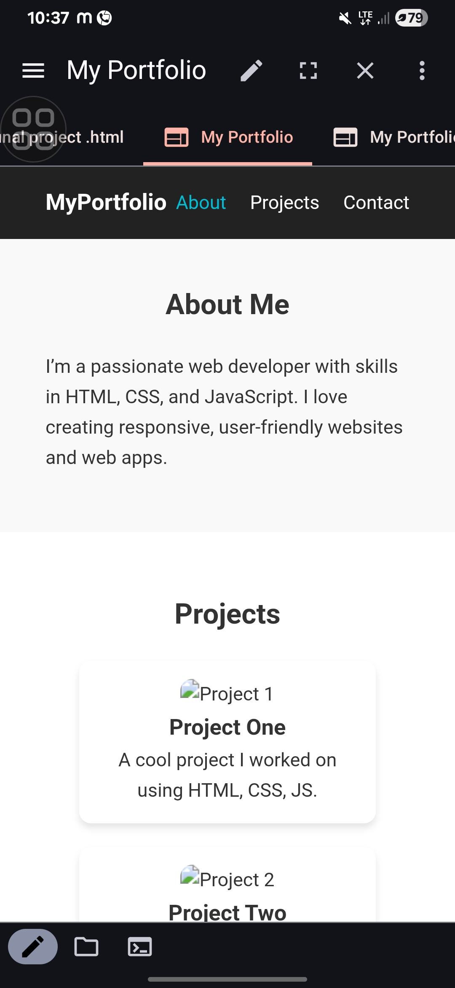

RESULTS AND SCREENSHOTS
3/21/2024 Annual Review
10

Slide 11
CONCLUSION
This portfolio project demonstrates how a simple yet elegant personal website can highlight skills, showcase projects, and allow easy communication. It provides a strong online presence for developers, increasing career and collaboration opportunities. With further improvements (like adding backend for contact form, integrating GitHub/LinkedIn links, and replacing placeholders with real projects), it can become a professional showcase for the developer’s journey.
11

